Slide 1

DIABETES TREND ANALYSIS
By Tomi Jegede
May 27, 2024

Slide 2
Project Overview
This project analysed diabetes trend using the Diabetes Dataset from Kaggle sourced from the National Institute of Diabetes and Digestive and Kidney Diseases.
The dataset focuses on diagnostic measurements among females of Pima Indian heritage aged 21 and above, to predict diabetes occurrence.
This project aims to identify key factors influencing diabetes, and explore age related patterns in diabetes occurrence.
The methodology involves using R for thorough data cleaning, exploratory data analysis to uncover insights, and visualization techniques to communicate findings effectively.

Slide 3
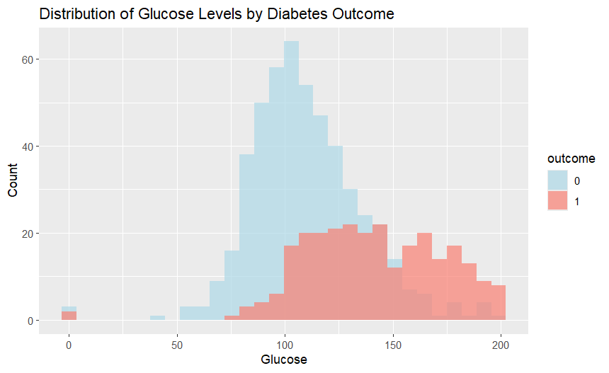
Data Analysis and Result
This is a histogram showing the Glucose levels for each woman in the dataset by the Outcome (0 for without diabetes and 1 for with diabetes). This graph shows that the glucose level is higher for women without diabetes than it is for women with diabetes.
Notes:
This is a histogram showing the Glucose levels for each woman in the dataset by the Outcome (0 for without diabetes and 1 for with diabetes). This graph shows that the glucose level is higher for women without diabetes than it is for women with diabetes.

Slide 4
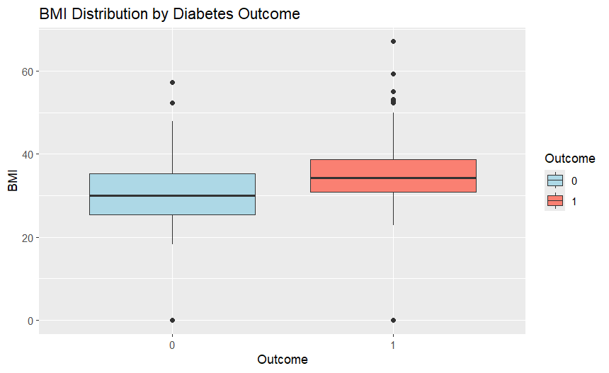
Data Analysis and Result
A boxplot showing the Body Mass Index (BMI) distribution by diabetes outcome. The women that do not have diabetes(0) have an average BMI of 30.
While the women that have diabetes(1) have an average BMI closer to 40.
Notes:
A boxplot showing the Body Mass Index (BMI) distribution by diabetes outcome. The women that do not have diabetes(0) have an average BMI of 30.
While the women that have diabetes(1) have an average BMI closer to 40.

Slide 5
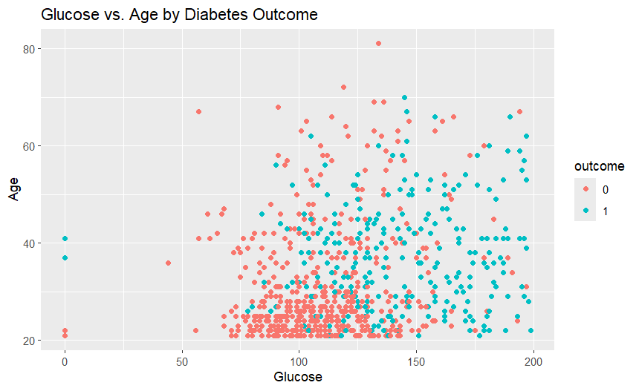
Data Analysis and Result
This scatterplot shows the relationship between glucose level and age based on diabetes outcome. For a lot of women under the age of 40 without diabetes(0), their glucose level is roughly between 70-140. For those with diabetes(1), the glucose level is roughly around 90-200 across all ages.
Notes:
This scatterplot shows the relationship between glucose level and age based on diabetes outcome. For a lot of women under the age of 40 without diabetes(0), their glucose level is roughly between 70-140. For those with diabetes(1), the glucose level is roughly around 90-200 across all ages.

Slide 6
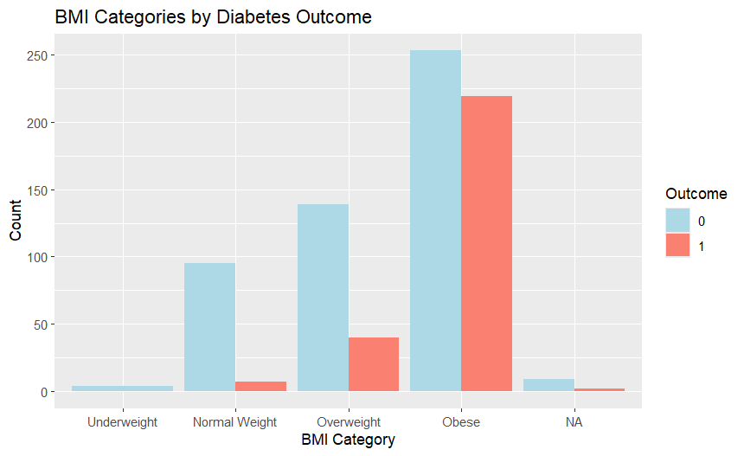
Data Analysis and Result
After categorizing all ages to groups according to their BMI, this graph shows the number of women with or without diabetes based on their category. For the ‘obese’ group, it has the highest number of women that either have diabetes or do not. This implies that body weight might not necessarily be a contributing factor to having diabetes. Although more research will have to be carried out.
Notes:
After categorizing all ages to groups according to their BMI, this graph shows the number of women with or without diabetes based on their category. For the ‘obese’ group, it has the highest number of women that either have diabetes or do not. This implies that body weight might not necessarily be a contributing factor to having diabetes. Although more research will have to be carried out.

Slide 7
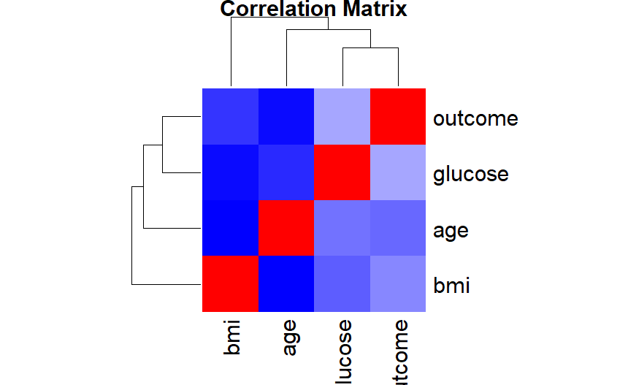
Data Analysis and Result
This heatmap shows the correlation matrix for the dataset highlighting how strongly variables like Glucose, BMI, Age, and Outcome are related to each other. Warmer colours indicate strong positive correlations, and cooler colours indicate negative correlations.
Notes:
This heatmap shows the correlation matrix for the dataset highlighting how strongly variables like Glucose, BMI, Age, and Outcome are related to each other. Warmer colours indicate strong positive correlations, and cooler colours indicate negative correlations.

Slide 8
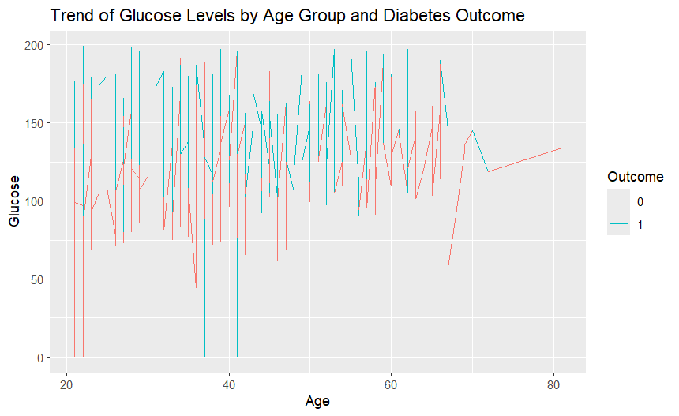
Data Analysis and Result
This line chart shows the Glucose levels by Age Group and Diabetes Outcome. The glucose levels are higher for women without diabetes in their 20s. It remains somewhat consistent for women with diabetes except for ages around 40.
Notes:
This line chart shows the Glucose levels by Age Group and Diabetes Outcome. The glucose levels are higher for women without diabetes in their 20s. It remains somewhat consistent for women with diabetes except for ages around 40.

Slide 9
Recommendations for Future Analysis
For future research, the following questions can be used to guide analysis:
How do changes in weight categories (e.g. from normal weight to overweight or obese) over time impact the risk of developing diabetes in women?
What genetic markers are associated with increased diabetes risk among specific populations, such as Pima India females?
What is the efficiency pf technology based interventions in improving diabetes self-management, monitoring and communication between patients and healthcare providers?

Slide 10
Reference
Akturk, M. (2021). Diabetes Dataset. Kaggle.
https://www.kaggle.com/datasets/mathchi/diabetes-data-set

Slide 11
THANK YOU

